Slide 1


PREDICTING SLEEP DISORDERS
Diana Fay Arbas, Joel Day, and Vannesa Salazar

Slide 2

Problem statement & Data description
This project aims to develop a predictive model using key predictors to automatically classify the presence or absence of sleep disorders. With sleep disorders affecting millions of Americans and posing serious health risks, accurately identifying them through predictive modeling can enable timely intervention and treatment, offering a more accurate, convenient, and cost-effective approach compared to traditional diagnostic methods.
Our team used the Sleep Health and Lifestyle Dataset on Kaggle. There were 374 observations across 13 variables.

Slide 3
EDA
The sleep disorder data set has 374 observations with 13 variables, including the target variable ~ whether the individual has a sleep disorder or not.
The dataset has numerical, ordinal, and categorical predictors.
There is an imbalance of the response variable as the dataset predicts a specific type of sleep disorder (Sleep Apnea, Insomnia, or None)
There is also an issue with BMI.Category. Normal is registered twice. Making the categories Normal/Normal Weight, Obese, Overweight

Slide 4
Data Pre-processing
The class imbalance of the response variable was corrected using stratified sampling. The response variable was also changed to a binary variable of either having a sleep disorder (1) or not (0).
BMI. Category was adjusted to remove weight from Normal, so that Normal Weight and Normal could be joined as one. Resulting in only 3 different category types.
Irrelevant and redundant predictors were dropped from the dataset specifically the duplicate column of Sleep Disorder, and Person ID.
Test/Training set was created with a more balanced response variable being depicted in both sets.
Dummy variables were created for the categorical predictors Occupation and BMI Category. Resulting in more attributes for the dataset to encompass a variety of employments and BMI types.
Near-zero variance predictors were removed for feature reduction.
Gender is transformed from Male/Female to 0/1.
Center & Scaling of predictor variables to get the distribution to normal like.

Slide 5
Data Pre-processing
Blood pressure column was split into two columns one for Systolic, and Diastolic numbers corresponding to the readings of a blood pressure screening. They were then transformed to numeric values.
These numbers were then placed in bins based on a threshold for low, normal, and high blood pressures. The original columns were then removed, resulting in one categorical column with three possible responses. These were then turned into dummy variables.
Check for multicollinearity using a correlation matrix. All highly correlated values over a threshold of 0.8 were removed.
There were a few highly correlated predictors with response and with each other, some were removed while others based on domain knowledge were kept in such as BMI-Overweight, and High Blood Pressure. Most others were removed to prevent overfitting.

Slide 6
Data splitting
Using the function createDataPartition in R the data was split using 70% in the training set and 30% in the testing set.
As previously mentioned, the data will be partitioned using stratified sampling to maintain the datasets response variable (Sleep Disorder) for both the training and test set.
This will lead to a better and more reliable model that can adapt to real life scenarios.

Slide 7
Model Building Strategies
Logistic Regression
Linear Discriminant Analysis
Penalized Logistic Regression
Nearest Shrunken Centroids
Neural Networks
Random Forests
Boosting
XGBoost
Bagged ADA Boost
We then compare their performances to select the final model.

Slide 8
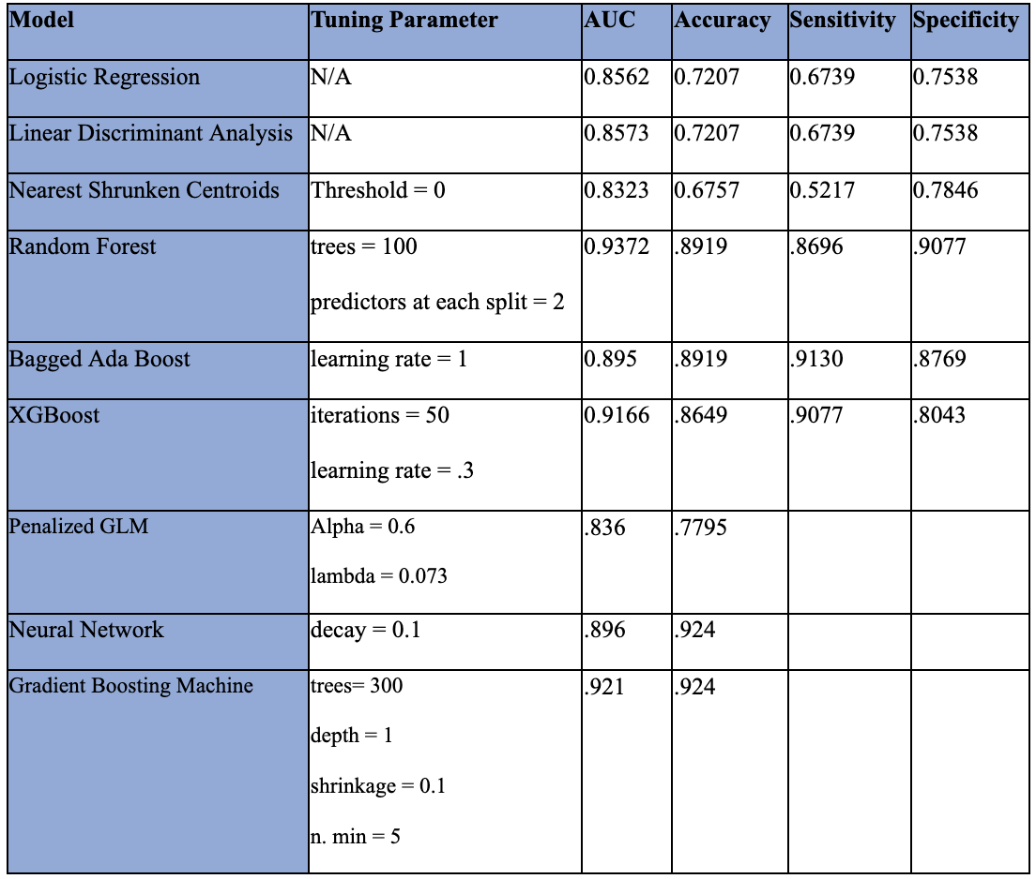
Model Performance and Hyperparameter Tuning

Slide 9
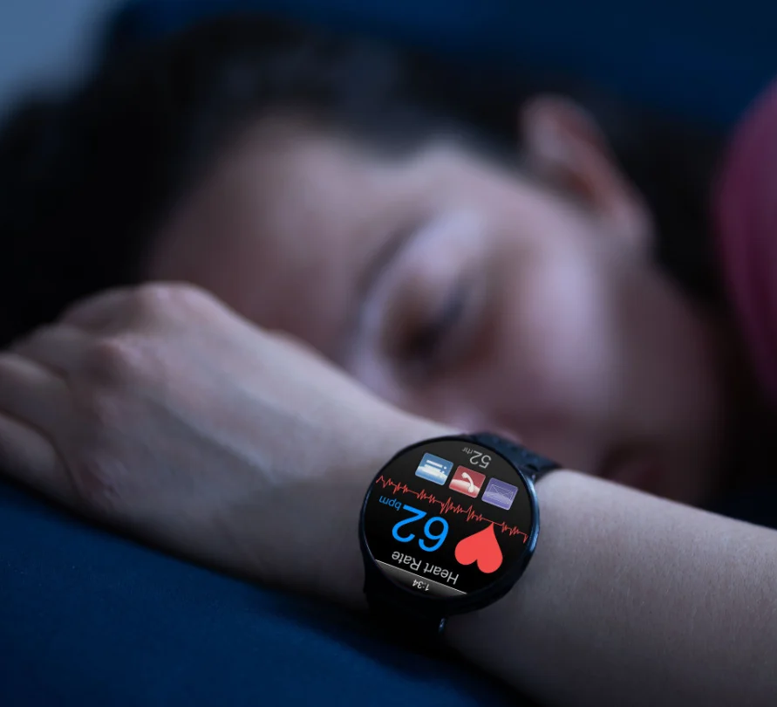
Discussion & Conclusion
The Random Forest Model is a powerful predictive modeling solution for sleep disorder classification.
Feature Importance: Age, Daily Steps, and Physical Activity Level
Future studies could explore additional predictors or real-time data from wearable devices
More efficient and targeted sleep disorder management

